Slide 1
Team LAST MINUTE

Slide 2
Learning through the looking glass
The Challenge :
NASA’s James Webb Space Telescope is the largest, most powerful, and most complex space science telescope ever built .
However, only a certain percentage of people know about its capabilities and how it deeply it affects our lives.
Our Solution :
Our objective is to create an educational game to help people understand and learn about the JWST in a fun and creative manner.

Slide 3
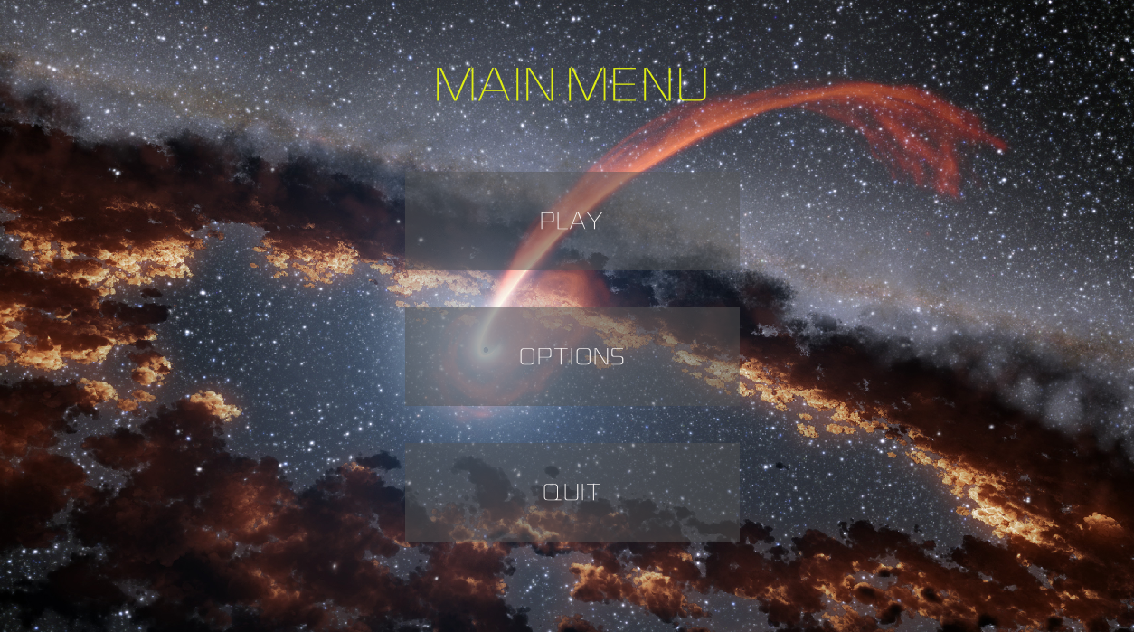
The jwst explorer
Since the launch of the JWST, many people have being talking about how great of an achievement it is, yet most of them do not know about its true capabilities and how powerful it really is.
Our team has developed a solution for this problem. We have developed a game that has many fun ways to learn about the JWST.
Through this game, the player can learn a lot about the JWST and put their knowledge to the test.

Slide 4
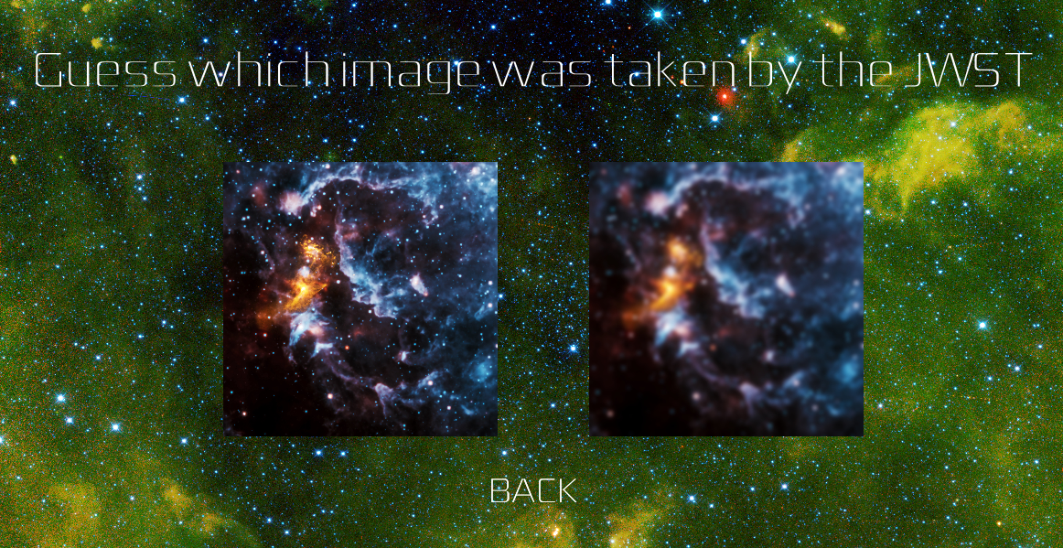
Levels
The game will have 3 levels :
Level - 1 (Basic) : This level will first tell some fun facts about the telescope and then begin with an guess the image game. It will compare two images and the player will have to choose the one which was taken by the JWST.
Level - 2 (Intermediate) : This level will show the images containing galaxies and the player will have to guess the types of galaxies in the picture.
Level - 3 (Advanced) : This level will show the rather complex images like the heat maps and atmospheric composition taken by the NIRCAM and the NIRSPEC. The player will also be shown two image taken by the JWST, one of them from its infrared camera, and will have to guess which one is which.

Slide 5
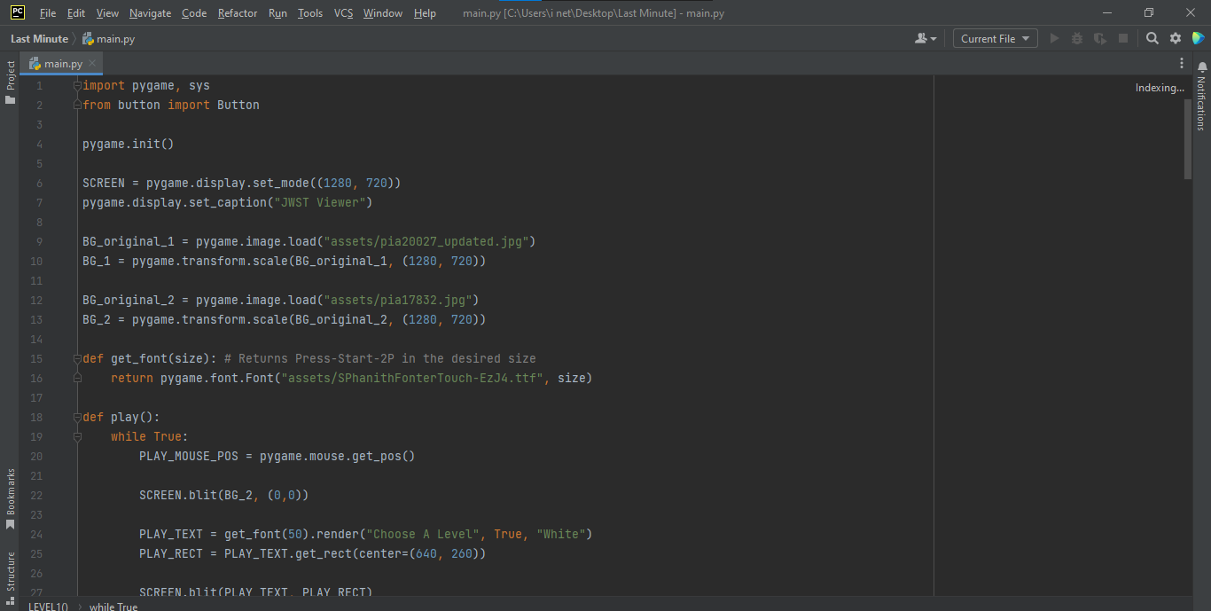
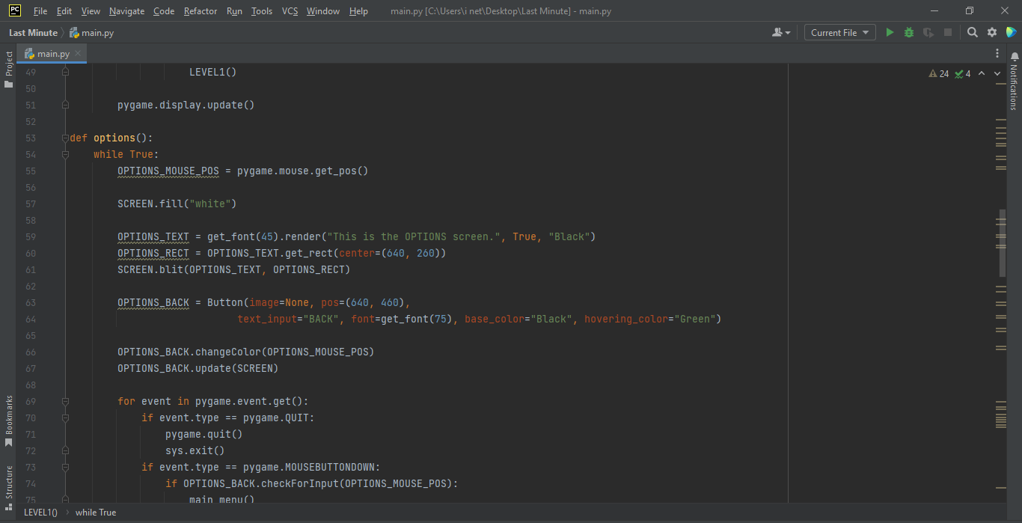
Our Future Plans
Due to the short deadline, the project had to be made in python to keep it as simple as possible. There are still multiple games and features to be added to it.
We aim to make this game available to all devices (Windows, iOS, Android) , and make it even more interactive.

Slide 6
Our Hackathon journey
During our hackathon journey, we ourselves learned a lot about the JWST and also got a chance to work together and like a team.
We also learned to improve on our skills like time management.
We would also like to thank NASA to provide all the resources we needed for our project and for organizing this hackathon which allowed us to solve real life problems.

